Slide 1
Company Law 6

Slide 2
Company Borrowing

Slide 3
Company Borrowing
Companies have implied and usually express powers to borrow.
A company will also have the power to give security for borrowing, either express or implied, by way of legal or equitable mortgage.
Companies can borrow from various sources, e.g. personal investors and financial institutions.

Slide 4
Debentures
Most loans are by way of debentures. A debenture is a document acknowledging a debt by a company.
A debenture usually provides security or a charge, which the lender can enforce by way of receivership if the debts fall into arrears.

Slide 5
Shares vs Debentures
A number of essential legal differences are involved in a company’s decision as to which form of security to issue:
1. A shareholder is an owner of the company; a debenture holder is a creditor.
2. On liquidation, debts to debenture holders are repaid in advance of repayments to shareholders.
3. The interest that a company pays on debentures is tax-deductible, making them attractive to companies.

Slide 6
Shares vs Debentures
A number of essential legal differences are involved in a company’s decision as to which form of security to issue:
…
4. A company may purchase its own debentures (unless the debenture provides otherwise). Redeemed debentures may be reissued.
5. A company may only pay dividends to shareholders out of profits; interest is due on debentures regardless of whether there is profit.

Slide 7
Types of Debentures
(a) A Single Debenture
The most common type in Ireland – an individual loan made to a company.
(b) A Series of Debentures
A group of separate loans issued on standard conditions, done to raise a total amount. The key condition is that all the debentures rank equally (or pari passu), although the loans may be created on different dates.

Slide 8
Types of Debentures
(c) Debenture Stock
Where a large group of lenders subscribes for debentures and the loan is treated as part of an overall stock figure.
It is used by public companies to raise finance from the public at large, and for convenience all the loans are treated as part of a fictional overall figure.
Each loan may be split into amounts, e.g. €10, and is transferable.

Slide 9
Debenture Trust Deed
A Debenture Trust Deed may be used with a series of debentures and debenture stock.
It is a legal document which appoints a trustee to act on behalf of all the debenture holders, to enforce the security and appoint the receiver.

Slide 10
Debenture Trust Deed
A Debenture Trust Deed usually contains:
1. name and address of trustee;
2. provision for payment of trustee;
3. statement that the trustee represents the interests of the debenture holder;
4. undertaking by the company to repay the loan and interest at specified times;
5. creation of a legal mortgage on the company’s assets which form the security;

Slide 11
Debenture Trust Deed
A Debenture Trust Deed usually contains:
6. statement of when the security may be enforced;
7. authorisation of the trustee to enforce the security and appoint a receiver in case of default;
8. undertaking by the company to maintain and insure the charged property;
9. detailed provisions dealing with a register of debenture stockholders, meeting of debenture holders, issue of certificates, transfer of stock etc.

Slide 12
Debenture Trust Deed
Advantages of a Debenture Trust Deed:
1. If a fixed charge is created, no later lender can obtain prior right to repayment.
2. Speed – the trustee can act more quickly than a group of individual debenture holders.
3. Convenience – individual debenture holders do not have to liaise with each other or supervise their investment.

Slide 13
Debenture Trust Deed
Disadvantage of a Debenture Trust Deed:
It’s an additional cost to the debenture holder.

Slide 14
Transferability of Debentures
Transferable according to the terms of the debenture itself.
‘Bearer Debentures’ – these are payable to the bearer – these are transferred by delivery, in the same way as share warrants.

Slide 15
Transferability of Debentures
‘Convertible Debentures’ – these may be converted into shares in the company at a specified rate of exchange.
Used where investors would be slow to buy shares in a company which may not make profits for some time to come.
No ban on a company issuing debentures at a discount.

Slide 16
Register of Debenture Holders
The company must keep a register of debenture holders, under S.91 of CA 1963.
The register must contain the names and addresses of the debenture holders and the amount of debentures held by each.
Register to be kept at company’s registered office, or at another place notified to the Registrar of Companies.
Companies Consolidation Act will repeal this requirement.

Slide 17
Company Charges
Debentures may be unsecured, but are usually secured by charges.
The secured creditor has a charge over the company’s assets and can enforce prior payment of his or her debts by appointing a receiver over those assets.
Charges may be fixed or floating .
Also a hybrid charge, a fixed charge over book debts.

Slide 18
Companies Consolidation Act
Introduces a new definition of a charge, which expressly excludes a mortgage or charge over an interest in cash, accounts or deposits in financial institutions or financial instruments.

Slide 19
Fixed Charge
This charge attaches to a specific asset like property, and the borrowing company cannot deal with the charged assets without the consent of the chargeholder.
A fixed charge can be by legal or equitable mortgage over the asset.

Slide 20
Fixed Charge
Advantages:
1. A fixed charge ranks in priority over a floating charge when it comes to repayment – first charge to be repaid.
2. Charged assets are easily identifiable.

Slide 21
Fixed Charge
Disadvantages:
It may be difficult for a receiver to dispose of assets at their book price because of devaluation and poor market conditions.

Slide 22
Floating Charge
This is a charge that does not attach to specific assets until a specified event which causes ‘crystallisation’.
It is an equitable charge.

Slide 23
Floating Charge
Floating charges were defined in Re Yorkshire Woolcombers Association Ltd, 1903 as having three features:
- a charge on a class of assets of a company present and future
- which class is, in the ordinary course of the company business, changing from time to time
- until the holder enforces the charge, the company may carry on business and deal with the charged assets.

Slide 24
Floating Charge
However, without having these three characteristics, a charge can still be a floating charge:
Welch v Bowmaker (Ireland) and BofI, 1980 Ire.
A floating charge was created over land, which is not an asset that changes from time to time. Held: This could still be a valid floating charge.

Slide 25
Floating Charge
A floating charge is typically created over stock or book debts, which are changing assets with which the company carries on business.
Floating charges usually created by companies which have already created fixed charges on all suitable assets, or where company does not have any asset suitable for creation of fixed charges.

Slide 26
Floating Charge
A floating charge ‘floats’ over the class of assets, such as stock, without affixing to any specific part of the asset. If a debt which a floating charge secures is paid, the charge simply ceases to exist.
However, if the security has to be enforced, the floating charge is said to ‘crystallise’, at which point it affixes to whatever part of the asset is available at that time.

Slide 27
Floating Charge
A floating charge that has crystallised is still a floating charge.
A floating charge crystallises:
- on the liquidation of a company;
- on the appointment of a receiver to the company;
- when the parties stipulate (some academic debate on this);
- on the cessation of the company’s business (includes the sale of a company’s business).

Slide 28
Floating Charge
A floating charge that has crystallised…
Re The Real Meat Co Ltd, 1995 Ire.
Held: the sale of the business was a cessation of a business which caused the floating charge to crystallise automatically.

Slide 29
Floating Charge
A floating charge which crystallises on the appointment of a receiver becomes a floating charge again on the appointment of an examiner
(Re Holidair Ltd, 1994 Ire.)

Slide 30
Advantages of
a Floating Charge
Assets subject to a floating charge may be easier to dispose of than assets subject to a fixed charge, e.g. disposability of stock vs buildings.
It may be the only option open to a company that has no fixed assets, or fixed assets that are already subject to charges.

Slide 31
Disadvantages of
a Floating Charge
1. Assets subject to a floating charge rank third in priority for payment, after fixed charges and preferential debts.
2. The precise value of the security is uncertain until crystallisation occurs.

Slide 32
Disadvantages of
a Floating Charge
3. They cannot take effect over goods which the company does not yet own, such as goods under a retention of title clause, or goods held under a hire purchase agreement.

Slide 33
Disadvantages of
a Floating Charge
4. A receiver can invalidate a floating charge in a number of ways:
- if a charge is not registered under S.99 of CA 1963
- if a charge is a fraudulent preference under S.286, CA 1963
- if a charge is created within one year of a company going into insolvent liquidation under S.288, CA 1963.

Slide 34
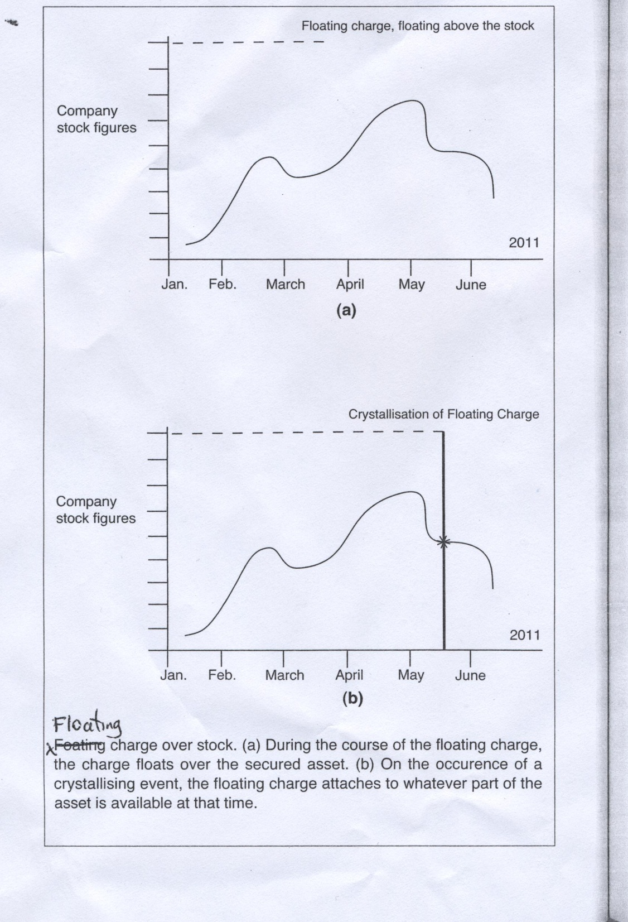
Floating Charges

Slide 35
Fixed Charge over Book Debts
-A hybrid charge.
-It would be permissible to create a floating charge over book debts, but it would still rank third after fixed charges and preferential debts.
-In 1980s, banks preferred to create such charges as fixed charges so as to take priority over preferential debts.
-Revenue Commissioners objected because these took priority over tax debts.
-Such schemes usually provided that the borrower was to collect the debts and keep them in a special bank account which would be frozen at a particular level.

Slide 36
Fixed Charge over Book Debts
-These sometimes known as Siebe Gorman clauses after the case of Siebe Gorman v Barclays Bank Ltd, 1977.
-Siebe Gorman clauses accepted by Irish Supreme Court in Re Keenan Brothers, 1985 Ire.
-But Court held that the charge could only attach to uncollected debts as collected debts would cease to exist.

Slide 37
Fixed Charge over Book Debts
- S. 115 of Finance Act 1986: Holder of a fixed charge over book debts is liable to pay the borrower’s debts to the Revenue Commissioners, if the company fails to pay.
- So Revenue has priority over fixed charges over book debts, and so these are rarely created any more.
- This position led to difficulties for small companies seeking to borrow from banks.
- So S.174 of Finance Act, 1995 provides that S.115 does not apply where “within 21 days of the creation of the fixed charge, the holder of the charge furnishes the Revenue Commissioners with a copy of the charge to be registered under S.99 of CA 1963.”

Slide 38
Fixed Charge over Book Debts
Re Holidair Ltd, 1994 Ire.
Holidair Ltd sought the protection of the appointment of an examiner for itself and 18 related companies, known as the Kentz Group. A bank claimed that Holidair had created a fixed charge over book debts in the bank’s favour in 1984 and thus the examiner could not borrow without their consent.
Held by Supreme Court: the 1984 charge over book debts was a floating charge, as it was over a class of assets that changed from time to time and the companies were free to draw monies from these bank accounts.

Slide 39
Fixed Charge over Book Debts
Re Holidair Ltd, 1994 Ire.
Also held by Supreme Court: a floating charge which had crystallised on the appointment of a receiver would begin to float again on the appointment of an examiner.

Slide 40
Registration of Charges
S.99 of CA 1963 provides that a company must register charges with the Registrar of Companies within 21 days of the creation of the charge. Nine types of charges must be registered – which covers almost every type of asset.
If the charge is not registered, the charge is void and the debt it secures is repayable immediately.

Slide 41
Registration of Charges
Thus, although the primary obligation to register is on the borrowing company, the lender should in practice ensure that the charge is registered as required, although the lender is not obliged to do so.
The company is not required to keep a register of charges, but must keep copies of every instrument of charge which requires registration at its offices.

Slide 42
Registration of Charges
NB: a key difference here:
The list of charges to be registered under S.99 is not exhaustive. So it is possible that a charge which defeats a later lender need not be registered or recorded, and the later lender is thus unaware of it.

Slide 43
Registration of Charges
When the Registrar issues a certificate of registration, that is conclusive evidence of compliance with the requirements of company law.

Slide 44
Companies Consolidation Act
CCA changes S.99 by repealing the categories of charges to be registered, and simply requiring every charge to be registered.

Slide 45
Late Registration
Charges must be registered within 21 days, but an extension of time may be given by the court under S.106 of CA 1963 if the delay was “accidental or due to inadvertence” and the extension is not prejudicial to any party, such as the creditors, shareholders or company.

Slide 46
Late Registration
If an extension of time is granted, it’s usually subject to proviso that the registration is not to affect the rights of parties who acquired rights before the actual time of registration.
Re Telford Motors Ltd, 1978 Ire.
Held: the court set aside later registration of a charge because unsecured creditors had acquired rights prior to the registration and were entitled to protection.

Slide 47
Companies Consolidation Act
CCA simplifies the filing requirement by giving priority to the creditor who files first in time, rather than who was first to create the charge. It also introduces a system of preliminary filing.

Slide 48
Priority of Charges
The basic order of priority for the payment of debts is:-
1. Fixed charges – rank in order of creation, i.e. oldest charges first.
2. Preferential debts – all rank equally (or pari passu).
3. Floating charges – rank in order of creation, i.e. oldest charges first.

Slide 49
Priority of Charges
Preferential debts in S.285, CA 1963 are:
- all local rates within the last 12 months
- all assessed taxes not exceeding 1 year’s assessment
- all PRSI in the past year
- all wages or salary within the last 4 months
- all accrued holiday pay

Slide 50
Priority of Charges
In more complicated cases, the following may also be used to decide the priority:
1. Fixed charges take priority over floating charges created over the same asset;
2. Legal charges take priority over equitable charges;
3. Floating charges rank in the order in which they were created, but a charge over a specific class of assets takes priority over an earlier charge over all the assets;

Slide 51
Priority of Charges
…
4. A company cannot create a second floating charge over the same assets ranking in priority over or equally with an existing floating charge;
5. A negative pledge clause (see below) is only valid if the holder of the subsequent charge has actual notice of the restriction;
6. A floating charge may be invalid under S.288 of CA 1963 if registered within 12 months of liquidation (or 2 years if in favour of a connected person), and the company was not solvent at the date of its creation.

Slide 52
Priority of Charges
…
7. Any charge may be invalid under S.286 of CA 1963 as a fraudulent preference, if created within 6 months of a liquidation (or 2 years if in favour of a connected person).

Slide 53
Negative Pledge Clause
A negative pledge clause is usually a feature of a floating charge.
It is a restriction on the borrowing company creating subsequent charges ranking in priority to the current one.
This is to avoid the fear that a floating charge would lose out to a later fixed charge.

Slide 54
Negative Pledge Clause
A negative pledge clause binds both parties and also any subsequent secured creditors, provided they have actual notice of the clause.

Slide 55
Negative Pledge Clause
A subsequent charge holder will generally be aware of the previous charge because of the requirement of registration, but may not be aware of the prohibition contained therein, because it is not one of the essential facts required for registration.

Slide 56
Negative Pledge Clause
Welch v Bowmaker and the Bank of Ireland, 1980 Ire.
A company gave Bowmaker a floating charge over their land containing a negative pledge clause. A month later the company gave the Bank of Ireland an equitable deposit of title deeds over the same property. The BofI were aware of the earlier floating charge, but did not know the details of its terms. On liquidation, there was insufficient money to pay both debts.
…/…

Slide 57
Negative Pledge Clause
Welch v Bowmaker and the Bank of Ireland, 1980 Ire.
…/…
Bowmaker argued tha the BofI as subsequent chargeholders should have constructive notice of the negative pledge clause in the prior floating charge, because such clauses were so common.
Held: Actual notice was required, and so the second charge took priority as it was a fixed charge.

Slide 58
Negative Pledge Clause
Re Salthill Properties Ltd (in receivership), 2006 SC
A receiver was appointed to SP Ltd by a bank. The receiver sought directions of the High Court under S.316 of CA 1963 as to whether three leases between SP Ltd and P Ltd contravened negative pledge clauses in three mortgages between SP Ltd and the bank.
Held: the leases did contravene the negative pledge clauses.
…/…

Slide 59
Negative Pledge Clause
Re Salthill Properties Ltd (in receivership), 2006 SC
…/…
The SC up held the HC. Directors of P Ltd witnessed execution of three mortgages, each containing NPCs. In the absence of evidence to the contrary, it must be assumed that the directors were aware of the contents.

Slide 60
Companies Consolidation Act
The CCA simplifies the priority of charges.
A charge will have priority based on filing.
However, priority is subject to any contrary agreement between the lenders.
Negative pledge clauses will no longer be registerable.

Slide 61
Invalidity of Charges
The liquidator can avoid paying certain charges:
1. Floating Charge invalid under S.288 of CA, 1963.
A floating charge may be invalid under S.288 as amended by S.136 of CA 1990, if registered within 12 months of a liquidation, unless it is proven that the company was solvent immediately after the creation of the charge. If the floating charge was created in favour of ‘a connected person’, any floating charge within the last 2 years shall be void.

Slide 62
Invalidity of Charges
The liquidator can avoid paying certain charges:
1. Floating Charge invalid under S.288 of CA 1963.
A floating charge may be invalid under S.288 as amended by S.136 of CA 1990, if registered within 12 months of a liquidation, unless it is proven that the company was solvent immediately after the creation of the charge. If the floating charge was created in favour of ‘a connected person’, any floating charge within the last 2 years shall be void.

Slide 63
Invalidity of Charges
A ‘connected person is defined by the CA 1990 as amended by the Civil Partnership Act, 2010 and means:
- a director or shadow director of the company;
- a director’s spouse or civil partner, parent, brother, sister, child;
- a trustee of a trust, the principal beneficiaries of which are a director, their spouse or children or any company they control;
…/…

Slide 64
Invalidity of Charges
A ‘connected person is defined by the CA 1990 as amended by the Civil Partnership Act, 2010 and means:
…/…
- a partner under the Partnership Act 1890;
- the sole member of a single member private limited company is a person connected with a director of that company (unless the contrary is shown).

Slide 65
Invalidity of Charges
Solvent means (for the purposes of S.288) having “an ability to pay its debts as they fall due”.

Slide 66
Invalidity of Charges
The liquidator can avoid paying certain charges:
2. Fraudulent Preference under S.286 of CA 1963.
S.286 as amended by S.135 of CA 1990 provides that any act relating to property done by a company which is unable to pay its debts, in favour of a creditor, with a view to giving such creditor a preference over other creditors, shall be invalid if created within 6 months of a liquidation.
…/…

Slide 67
Invalidity of Charges
2. Fraudulent Preference under S.286 of CA 1963.
…/…
In other words, where a company is in financial difficulty and does something in an attempt to fraudulently prefer one creditor over another, this will be invalid. Typically, where a company has a number of unsecured creditors, it might create a floating charge in favour of one creditor, with the result that they are in a favourable position when the company is wound up. However, such a transaction will not be valid if it is within 6 months of the company being wound up, or within 2 years if the transaction is in favour of a connected person.

